Slide 1
Unit 9: Chapter 26
Frameworks

Slide 2
Framework vs. Methodology
Framework provides guidance to the developer in choosing methods, techniques and tools
Methodology is a step-by-step approach

Slide 3
Unit 8: Multiview

Slide 4
Multiview 1 – five stages
Analysis of human activity
Analysis of information (sometimes called information modelling)
Analysis and design of socio-technical aspects
Design of the human–computer interface
Design of technical aspects

Slide 5
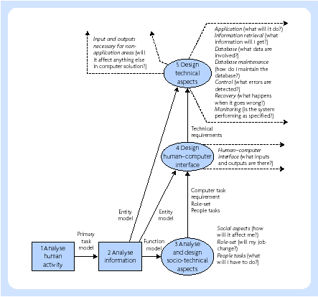
Multiview 1 – framework

Slide 6
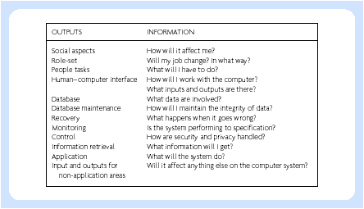
Multiview 1 – outputs

Slide 7
Unit 8: SODA

Slide 8
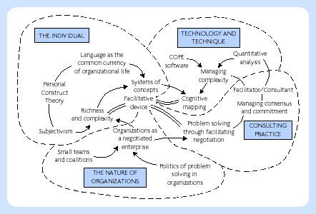
SODA – theory and concepts

Slide 9
Unit 8: CMM

Slide 10
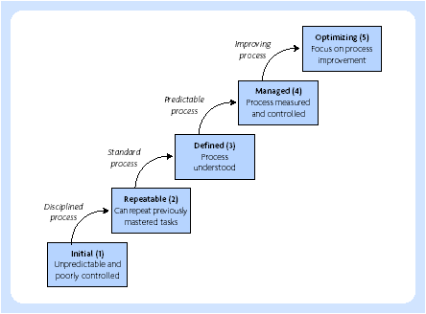
CMM – five levels

Slide 11
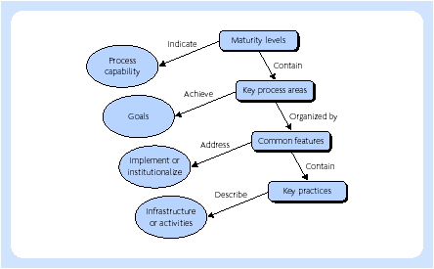
CMM - structure

Slide 12
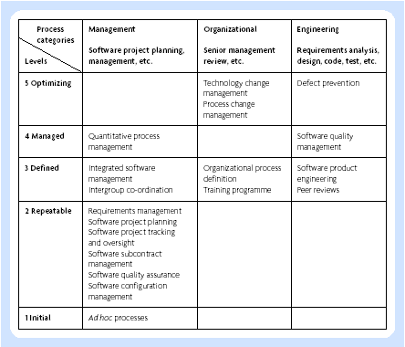
CMM - KPAs

Slide 13
Unit 8: Euromethod

Slide 14
Euromethod
SSADM from the UK
Merise from France
DAFNE (DAta and Function NEtworking) from Italy
SDM (System Development Methodology) from the Netherlands
MEIN (MEtodológica INformática) from Spain
Vorgehensmodell from Germany
IE (Information Engineering) from the UK/US

Slide 15
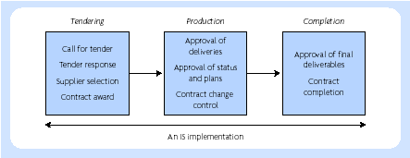
Types of transaction in an IS adaption

Slide 16
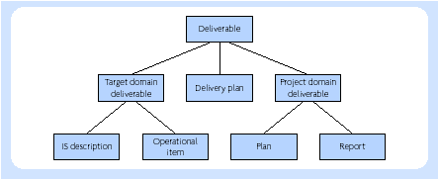
An hierarchy of deliverables

Slide 17
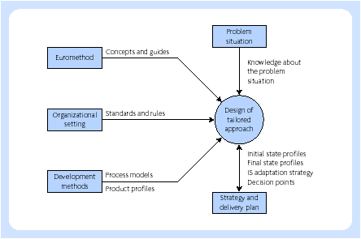
Euromethod – planning process

